Slide 1
IV3 – DataLake Management Tool for Media

Slide 2

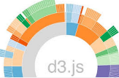
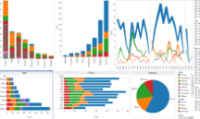
IV3- Logical Architecture and Business Use case
IV3 on top of Hadoop Distributed File System
Data Sources
Batch Data Processing
Analytics
Visualization
Social data
HDFS
Reports
Repair Data
Hive
Maintenance Data
Diagnostics Log Files
R
Programming
D3.js
ClickStream Data
Flume
Kafka
Storm
NLP
Tableau
Streaming Data Processing

Slide 3
THANK YOU

